Slide 1
Coursera Capstone IBM Data Science Certificate
BATTLE OF THE NEIGHBORHOODS PART 2 LOUDOUN COUNTY VIRGINIA
Presented by: Jason t. meil

Slide 2
Where to put a Retaurant in Loudoun County?
Loudoun County is the Wealthiest County in the Nation
Loudoun County has the highest per capita median income in the nation.
Loudoun County is located 25 miles west of Washington DC
Loudoun County is the the world’s hub of the internet with over 80% of all internet and cloud traffic moving through the county.
The County is in significant growth mode and projects a huge increase in population

Slide 3
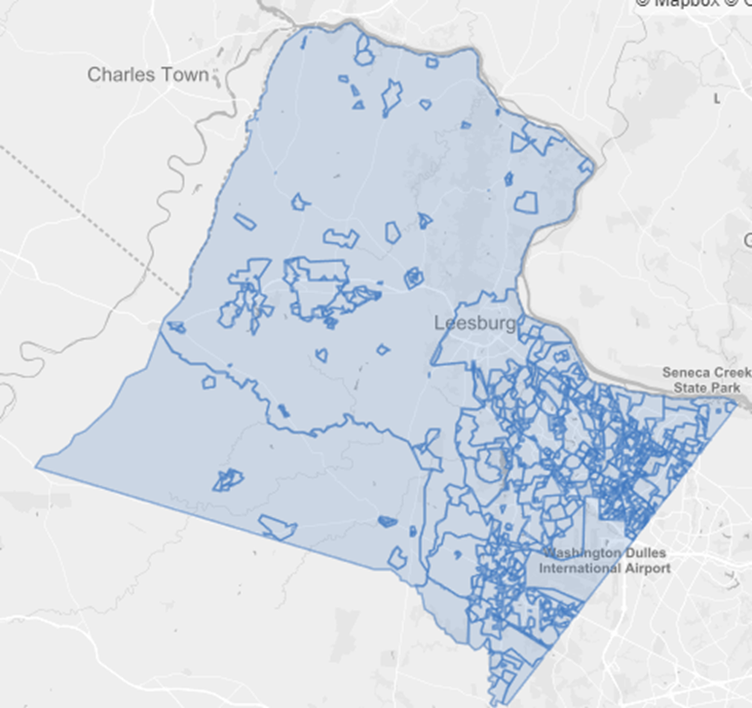
But, is it that easy? …
The area is already densely populated with restaurants, winery’s, breweries, fresh farm markets, and other food and entertainment venues.
I subdivided the county into its 8 subdivisions and from there began to analyze three variables:
Population of the area
Median income of the area
Commercial Cost of Rent
HERE IS WHAT I FOUND …..

Slide 4
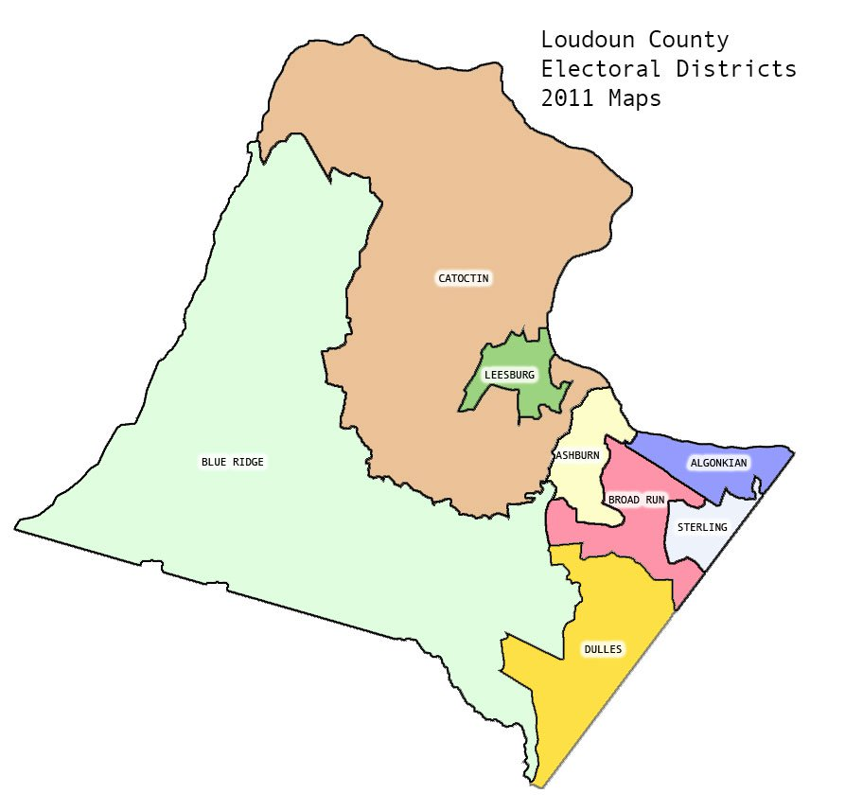
The Wealthiest Subdivisions
The Wealthiest Subdivisions in the County based on per capita income:
Blue Ridge District
Catoctin District
Holds the County Seat, Leesburg.

Slide 5
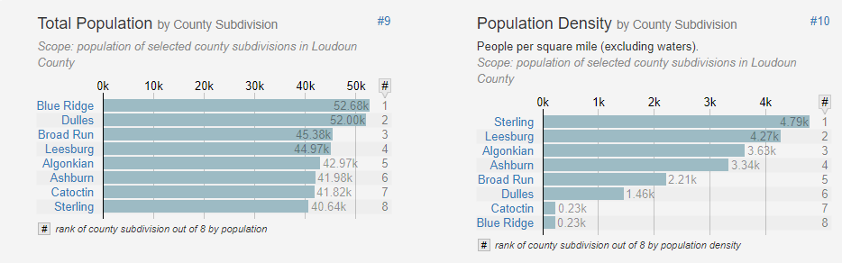
Population Distribution by subdivisions both total and as a percentage

Slide 6
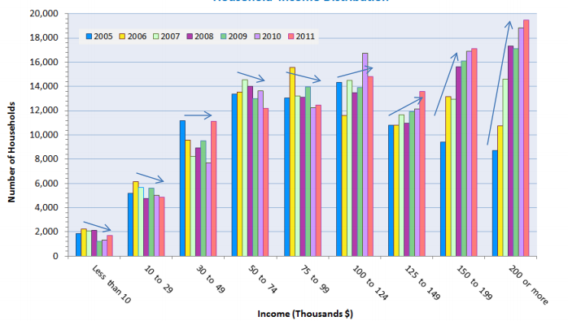
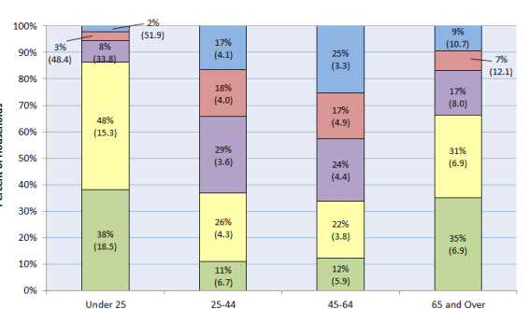
Income Distributions by age and number of households.

Slide 7

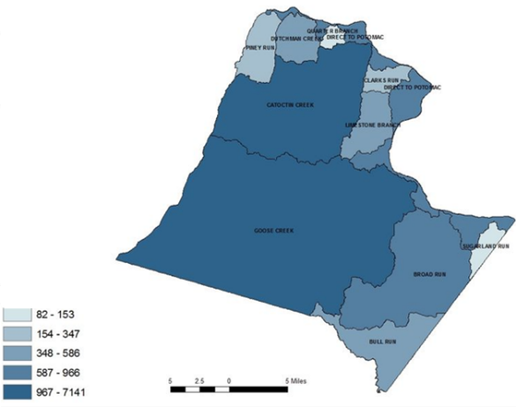



Commercial Rent Statistics
The Commercial Rent Districts in the County in order
Blue Ridge District
Catoctin District
Leesburg
Ashburn
BroadRun
Dulles
Algonkian
Sterling

Slide 8
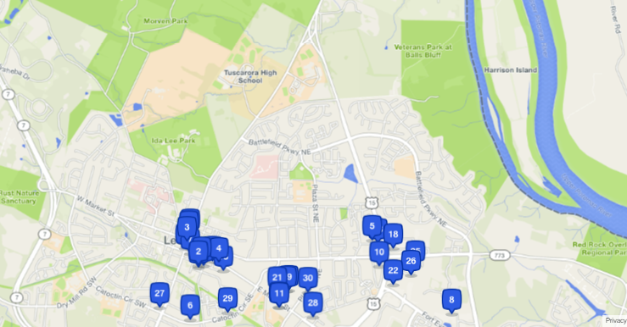
Where should we put the restaurant:

